Slide 1
Unit 3 Overview of Transformation
Dudhmale M.N

Slide 2

Transformation
Transformation changes the way object appears.
Implementing changes in size of object, its position on screen or its orientation called Transformation.

Slide 3
instantiation…
train
animation…
viewing…
image
wheel
modelling…

Slide 4
Basic 2D Transformation
Translation
Scaling
Rotation

Slide 5
Translation
Translation is a process of changing the position of an object in a straight line path from one coordinate location to another.

Slide 6
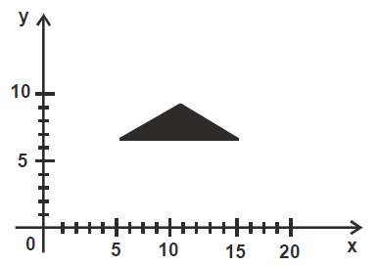
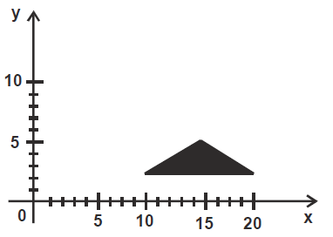
Translation

Slide 7
Translation
Translate over vector (t_{x}, t_{y})
x’=x+ t_{x}, y’=y+ t_{y}
or
y
P+T
T
P
x

Slide 8
Translation
A translation moves all points in an object along the same straight-line path to new positions.
The path is represented by a vector, called the translation or shift vector.
We can write the components:
p'_{x} = p_{x} + t_{x}
p'_{y} = p_{y} + t_{y}
or in matrix form:
P' = P + T
?
=4
t_{y}
t_{x}
= 6
(2, 2)
x’
y’
x
y
t_{x}
t_{y}
= +

Slide 9
Translation polygon
Translate polygon:
Apply the same operation on all points.
Works always, for all transformations of objects defined as a set of points.
y
T
x

Slide 10
Exercise
Translate a polygon with coordinates A(2,5), B (7, 10), and C (10, 2) by 3 units in x direction and 4 units in y direction

Slide 11
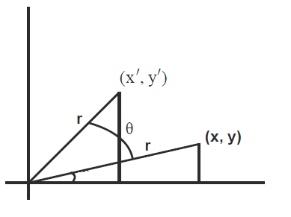
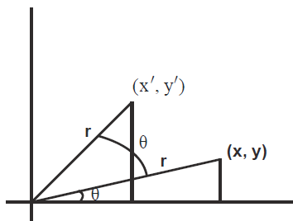
Rotation
Rotation transformation reposition an object along a circular path in the xy plane.
The rotation is performed with certain angle θ, known as rotation angle
x = r cos ϕ
y = r sin ϕ
x’ = r cos (ϕ + θ)
y’ = r sin (ϕ + θ)
ᶲ
ᶲ

Slide 12
Cont….
x’ = r cos (ϕ + θ)
y’ = r sin (ϕ + θ)
x’ = r cos ϕ cos θ – r sin ϕ sin θ - since cos (A+B)
y’ = r cos ϕ sin θ + r sin ϕ cos θ - since sin (A+B)
x’ = x cos θ – y sin θ
y’ = x sin θ + y cos θ

Slide 13
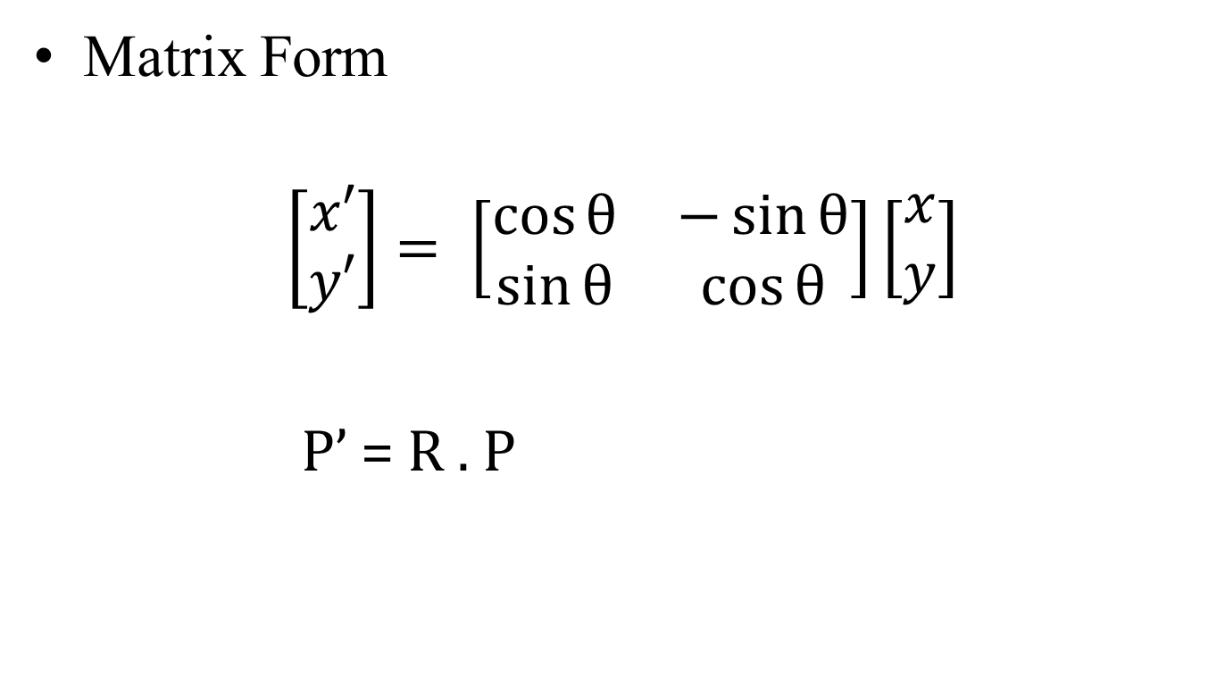
Rotation
Matrix Form
$$\left[\begin{matrix}x′ \\ y′\end{matrix}\right]= \left[\begin{matrix}\cos{θ} & −\sin{θ} \\ \sin{θ} & \cos{θ}\end{matrix}\right]\left[\begin{matrix}x \\ y\end{matrix}\right]$$
P’ = R . P

Slide 14
Rotation
A rotation repositions all points in an object along a circular path in the plane centered at the pivot point.
First, we’ll assume the pivot is at the origin.
P’
θ
P

Slide 15
Review Trigonometry
=> cos φ = x/r , sin φ= y/r
x = r. cos φ, y = r.sin φ
=> cos (φ+ θ) = x’/r
x’ = r. cos (φ+ θ)
x’ = r.cosφcosθ -r.sinφsinθ
x’ = x.cos θ – y.sin θ
=>sin (φ+ θ) = y’/r
y’ = r. sin (φ+ θ)
y’ = r.cosφsinθ + r.sinφcosθ
y’ = x.sin θ + y.cos θ
P’(x’, y’)
θ
r
y’
P(x,y)
θ
r
y
φ
x’
x
Identity of Trigonometry

Slide 16
Rotation
We can write the components:
p'_{x} = p_{x} cos θ – p_{y} sin θ
p'_{y} = p_{x} sin θ + p_{y} cos θ
or in matrix form:
P' = R • P
θ can be clockwise (-ve) or counterclockwise (+ve as our example).
Rotation matrix
P’(x’, y’)
θ
y’
P(x,y)
θ
r
y
φ
x’
x

Slide 17
Scaling
Scaling changes the size of an object and involves two scale factors, S_{x} and S_{y} for the x- and y- coordinates respectively.
Scales are about the origin.
We can write the components:
p'_{x} = s_{x} • p_{x}
p'_{y} = s_{y} • p_{y}
or in matrix form:
P' = S • P
Scale matrix as:
P’
P

Slide 18
Scaling
If the scale factors are in between 0 and 1 ➔ the points will be moved closer to the origin ➔ the object will be smaller.
P’
Example :
P(2, 5), Sx = 0.5, Sy = 0.5
Find P’ ?
P(2, 5)
If the scale factors are larger than 1 ➔ the points will be moved away from the origin ➔ the object will be larger.
P’
Example :
P(2, 5), Sx = 2, Sy = 2
Find P’ ?

Slide 19
If the scale factors are the same, S_{x} = S_{y} ➔ uniform scaling
Only change in size (as previous example)
P’
If S_{x} ≠ S_{y} ➔ differential scaling.
Change in size and shape
Example : square → rectangle
P(1, 3), S_{x} = 2, S_{y} = 5 , P’ ?
P(1, 2)

Slide 20
Homogeneous Coordinates
Basic Transformations
Translation
P’=TP
Rotation [O]
P’=RP
Scaling
P’=SP

Slide 21
Homogeneous Coordinates
Basic Transformations
Translation
P’=TP
Rotation [O]
P’=RP
Scaling
P’=SP

Slide 22
Other Transformation
Reflection
Produces a mirror image of an object relative to an axis of reflection.
Shear
A transformation that slants the shape of an object is called the shear transformation
X Shear
preserves y coordinates but changes x values
Y Shear
preserves x coordinates but changes y values

Slide 23
Other transformations
Reflection:
x-axis y-axis

Slide 24
Other transformations
Reflection:
origin line x=y

Slide 25
Other transformations
Shear:
x-direction y-direction
Y’=y
X’=x+shx*y
x’=x
y’=y+shy*x

Slide 26
Rotating About An Arbitrary Point
What happens when you apply a rotation transformation to an object that is not at the origin?
Solution:
Translate the center of rotation to the origin
Rotate the object
Translate back to the original location

Slide 27
Rotating About An Arbitrary Point
y
y
x
x
y
y
x
x

Slide 28
Rotation About a Pivot Point
(x’,y’)
(x,y)
(x_{p} , y_{p})
Pivot Point
Pivot point is the point of rotation
Pivot point need not necessarily be on the object

Slide 29
Cont..
STEP-1: Translate the pivot point to the origin
(x,y)
(x1, y1)
(x_{p} , y_{p})

Slide 30
Cont..
STEP-2: Rotate about the origin
(x2, y2)
(x1, y1)

Slide 31
Cont..
STEP-3: Translate the pivot point to original position
(x’, y’)
(x2, y2)
(x_{p}, y_{p})

Slide 33
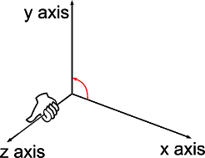
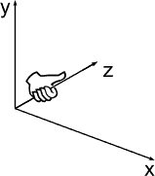
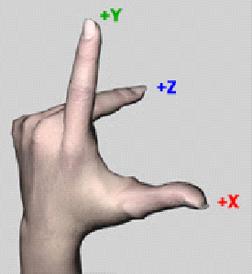
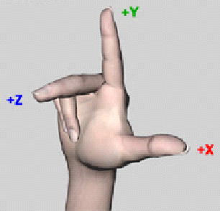
3D Coordinate Systems
Right Hand coordinate system:
Left Hand coordinate system:

Slide 34
3 D Translation
In translation, an object is displaced and direction from its original position.
The new object point p’=(x’,y’,z’) can be found by applying the transform Ttx,ty,tz to p=(x,y,z)
Here tx=distance moved by object along x-axis
ty=distance moved by object along y-axis
tz=distance moved by object along z-axis

Slide 35
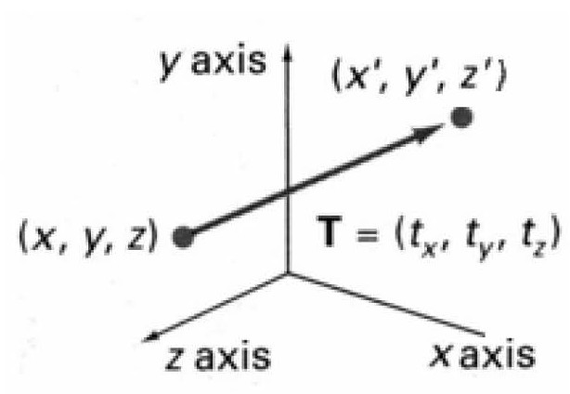
3D Translation
P is translated to P' by:
x’=x+tx
y’=y+ty
z’=z+tz

Slide 36
3D Translation
An Object represented as a set of polygon surfaces, is translated by translate each vertex of each surface and redraw the polygon facets in the new position.

Slide 37
3D Rotation
In general, rotations are specified by a rotation axis and an angle.
In two-dimensions there is only one choice of a rotation axis that leaves points in the plane.

Slide 38
3D Rotation
The easiest rotation axes are those that parallel to the coordinate axis.
Positive rotation angles produce counterclockwise rotations about a coordinate axis, if we are looking along the positive half of the axis toward the coordinate origin.

Slide 39
Coordinate Axis Rotations

Slide 40
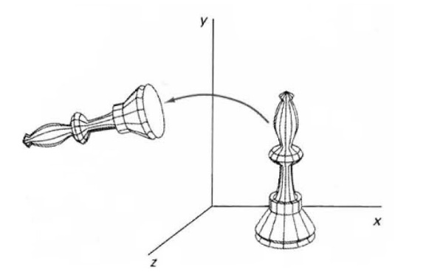
Coordinate Axis Rotations
Z-axis rotation: rotation about z-axis in anticlockwise direction

Slide 41
Cont..
Note that the +ve values of rotation angle Ө will produce a rotation in the anticlockwise direction whereas –ve values of Ө produce a rotation in the clockwise direction.
in this case angle Ө is taken as –ve. According to the trigonometric law
cos(-Ө)= cos Ө
sin(- Ө)= -sin Ө
Now the matrix become

Slide 42
z’=z
x’= x *cos θ – y *sin θ
y’= x*sin θ + y* cos θ

Slide 43
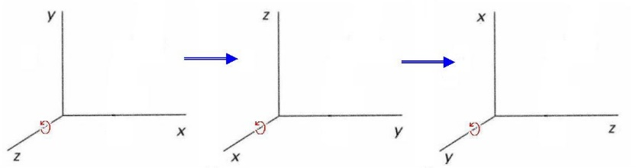
Coordinate Axis Rotations
Obtain rotations around other axes through cyclic permutation of coordinate parameters:

Slide 44
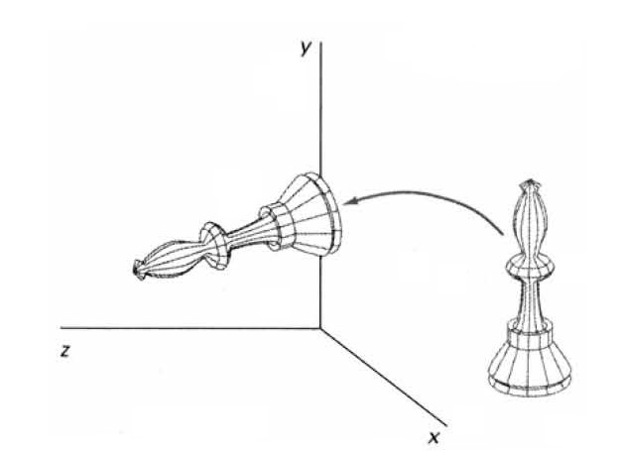
X-axis rotation
x’=x
y’= y *cos θ – z *sin θ
z’= y*sin θ + z* cos θ
Y’=ycos

Slide 45
X-axis rotation in anticlockwise direction:
X-axis rotation in clockwise direction:
In this case angle Ө is taken as –ve. According to the trigonometric law
cos(-Ө)= cos(Ө)
sin(- Ө)= -sin Ө

Slide 46
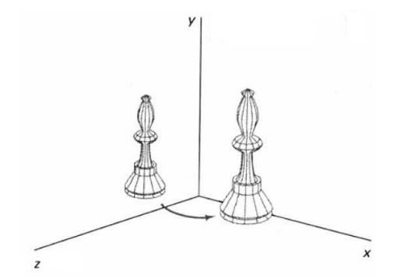
Y-axis rotation
y’=y
z’= z *cos θ – x *sin θ
x’= z*sin θ + x* cos θ

Slide 47
Scaling Transformation
A scaling transformation alters the size of an object.
An object can be scaled (stretched or shrunk) along the x, y and z axis by multiplying all its points by the scale factors Sx, Sy, Sz
All points P(x, y, z) on the scaled shape will now become P’(x’, y’, z’). Such that
x’=x.Sx
y’=y,Sy
z’=z.Sz

Slide 48
3D Scaling
Sx, Sy and Sz are scaling factors along x, y and z directions..
P’(x’y’z’)
Scaling
P(x,y,z

Slide 49
Scaling Transformation
If values of Sx, Sy and Sz<1 then size of objects reduced or the object move closer to the coordinate origin.
If values of Sx, Sy and Sz>1 then size of objects increased or the object move farther to the coordinate origin.
x’=x. Sx
y’=y. Sy
z’=z. Sz

Slide 50
Projections
Transform 3D objects on to a 2D plane
2 types of projections
Perspective
Parallel
In parallel projection, coordinate positions are transformed to the view plane along parallel lines.
In perspective projection, object position are transformed to the view plane along lines that come together to a point called projection reference point

Slide 51
Parallel Projection
Z coordinate is discarded.
Parallel lines from each vertex on the object are extended until they intersect the view plane.
The point of intersection is the projection of vertex.
Projected vertices are connected by line segments to correspond connection on original object.

Slide 52
Parallel Projection

Slide 53
Perspective Projection
Produces realistic views but does not preserves relative proportions.
Lines of projection are not parallel.
Instead they all converge at single point called projection reference point.

Slide 54
Perspective Projection

Slide 55
Question Bank
Solve following question …………2 Marks
List 2D/ 3D transformation………….R
Define scaling……………………….R
Define translation………………………R
List the type of projection……………….R
Write 2D matrix for translation/rotation/scaling ……R

Slide 56
Question Bank
6. What is need of homogeneous coordinate………U
7. What is reflection/ shearing transformation ……..U
8 . Write 3D matrix of translation/rotation/scaling…….U

Slide 57
Question Bank
Solve following question …………4 Marks
Derive the transformation matrix for rotation about arbitrary point………….A
Explain the perspective projection……………U
Write 3D transformation along with homogenous coordinate……………………U
Explain the parallel projection……….. ……U

Slide 58
Question Bank
Solve following question …………6 Marks
1. Find transformation of triangle A(1,0), B(0,1), C(1,1) by
a) Rotating 45 about origin & then translating one unit in x & y direction
b) Translating one unit in x & y direction & then rotating 45 about the origin….(A )
2. Apply the shearing transformation to square with A(0,0), B(1,0),C( 1,1) & D(0,1) as given below
Shear parameter value of 0.5 relative to the line y ref= -1
Shear parameter value of 0.5 relative to the x ref= -1……… (A )
3. Describe 3D rotation transformation …………….. (U)

Slide 59
Question Bank
Solve following question …………6 Marks
1. Consider the square A (1,0) , B(0,0) ,C(0,1), D)1,1 .Rotate the square by 45 anticlockwise direction followed by reflection about x- axis….(A )
2. Perform a 45 rotation of triangle A(0,0), B(1,1),C( 5,2) as given below
About origin
About P(-1,-1)……………..……… (A )
3. Consider the square A (1,0) , B(0,0) ,C(0,1), D)1,1 .Rotate the square by 45 anticlockwise direction about point A( 1,0) …………….. (A)

